Slide 1



Bank_data
View in Power BI
Last data refresh:
6/18/2025 10:41:11 AM UTC
Downloaded at:
6/18/2025 11:37:15 AM UTC

Slide 2
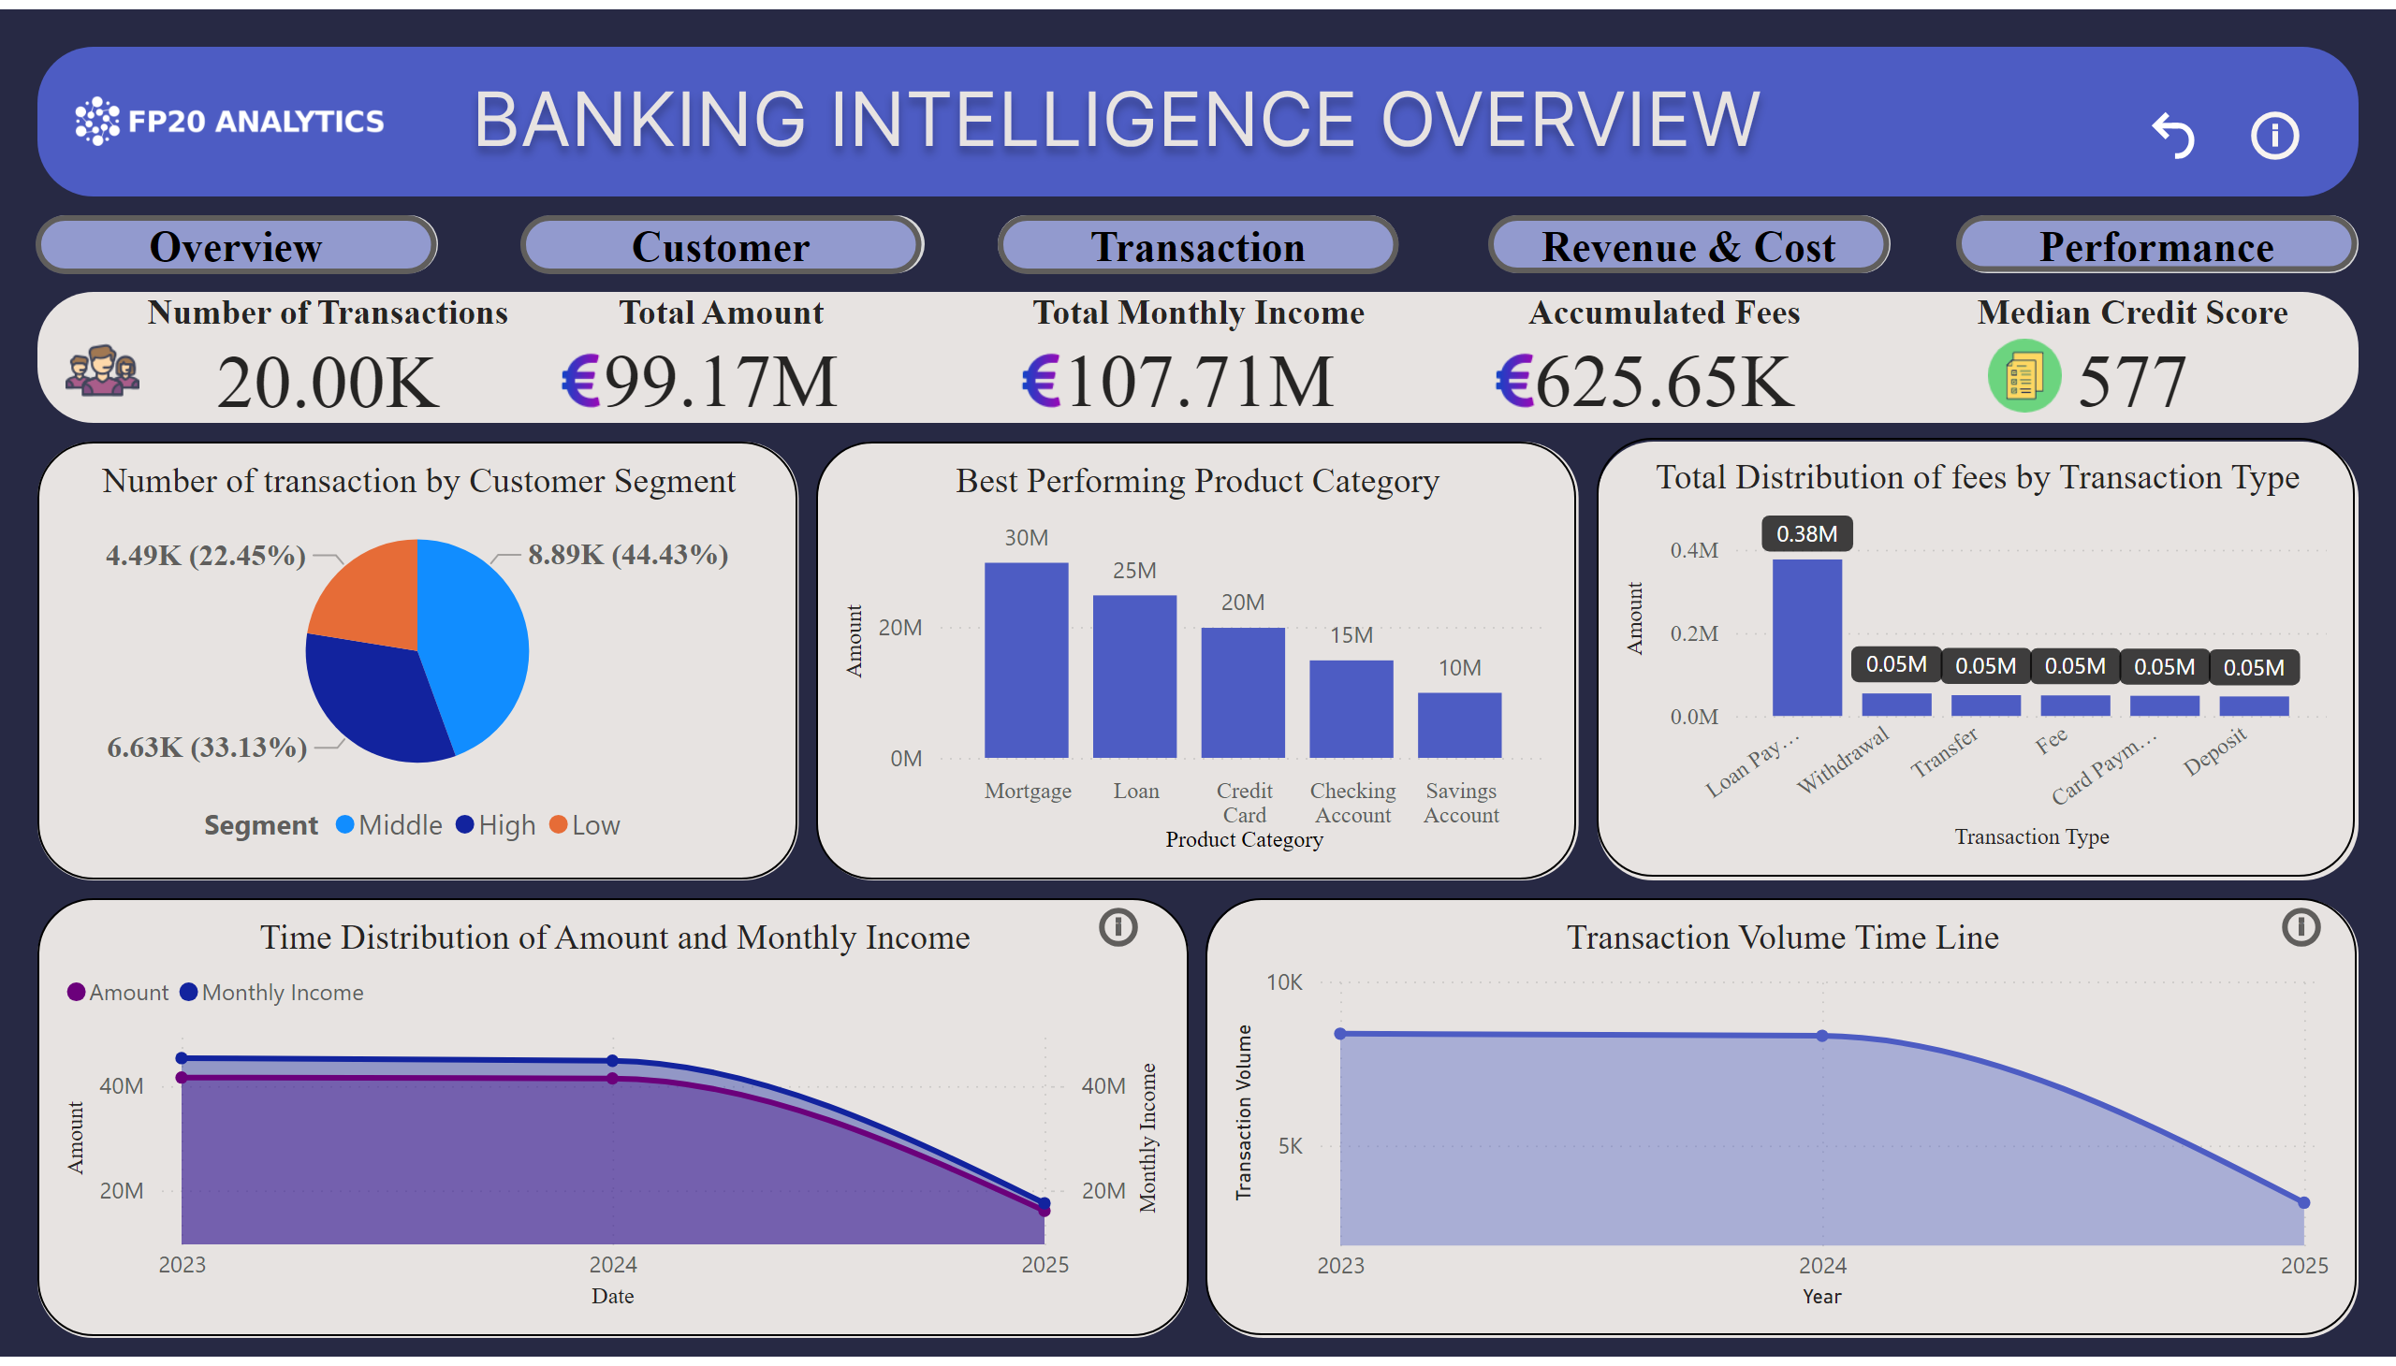
Overview
Notes:
actionButton
No alt text provided
actionButton
No alt text provided
card
No alt text provided
card
No alt text provided
Info Button
No alt text provided
Overview Button
No alt text provided
Transaction Button
No alt text provided
Revenue and Cost button
No alt text provided
Customer Button
No alt text provided
Performance Button
No alt text provided
image
No alt text provided
Overview Reset
No alt text provided
Number of Transactions
No alt text provided
Total Amount
No alt text provided
Total Monthly Income
No alt text provided
Accumulated Fees
No alt text provided
Median Credit Score
No alt text provided
Euro Image
No alt text provided
Euro Image
No alt text provided
Euro Image
No alt text provided
Score Image
No alt text provided
image
No alt text provided
Time Distribution of Amount and Monthly Income
No alt text provided
Transaction Volume Time Line
No alt text provided
Number of transaction by Customer Segment
No alt text provided
Best Performing Product Category
No alt text provided
Total Distribution of fees by Transaction Type
No alt text provided
image
No alt text provided

Slide 3
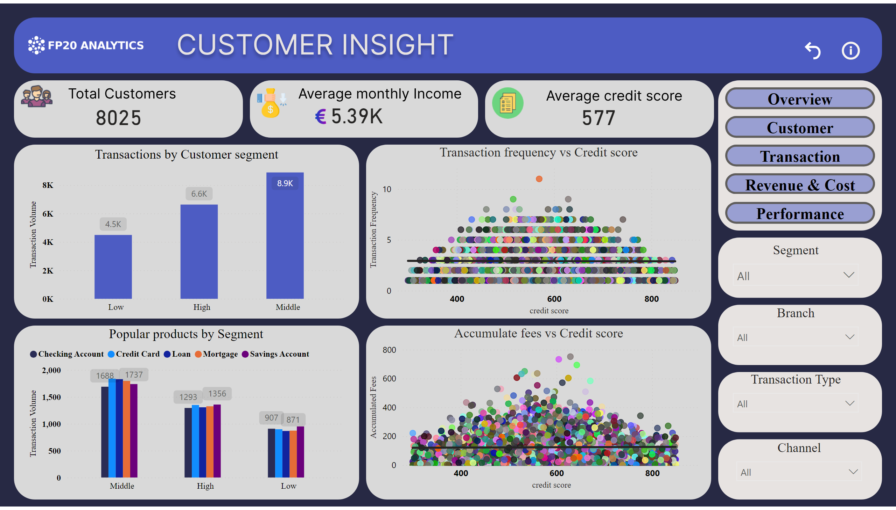
Customer segment
Notes:
Segment
No alt text provided
Branch
No alt text provided
Channel
No alt text provided
actionButton
No alt text provided
card
No alt text provided
card
No alt text provided
card
No alt text provided
image
No alt text provided
Transaction Type
No alt text provided
Transactions by Customer segment
No alt text provided
Popular products by Segment
No alt text provided
Transaction frequency vs Credit score
No alt text provided
Accumulate fees vs Credit score
No alt text provided
actionButton
No alt text provided
actionButton
No alt text provided
actionButton
No alt text provided
actionButton
No alt text provided
actionButton
No alt text provided
image
No alt text provided
actionButton
No alt text provided

Slide 4
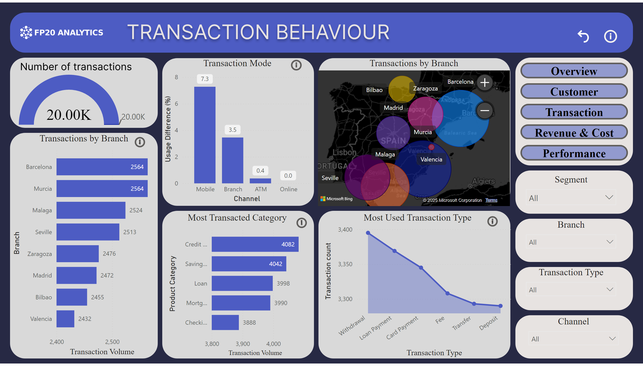
Transaction Behaviour
Notes:
Segment
No alt text provided
Branch
No alt text provided
Channel
No alt text provided
actionButton
No alt text provided
Transaction Type
No alt text provided
actionButton
No alt text provided
actionButton
No alt text provided
actionButton
No alt text provided
actionButton
No alt text provided
actionButton
No alt text provided
image
No alt text provided
actionButton
No alt text provided
gauge
No alt text provided
Transaction Mode
No alt text provided
Transactions by Branch
No alt text provided
Most Transacted Category
No alt text provided
Transactions by Branch
No alt text provided
Most Used Transaction Type
No alt text provided
actionButton
No alt text provided
card
No alt text provided
image
No alt text provided
actionButton
No alt text provided
actionButton
No alt text provided
actionButton
No alt text provided
card
No alt text provided
card
No alt text provided
card
No alt text provided

Slide 5
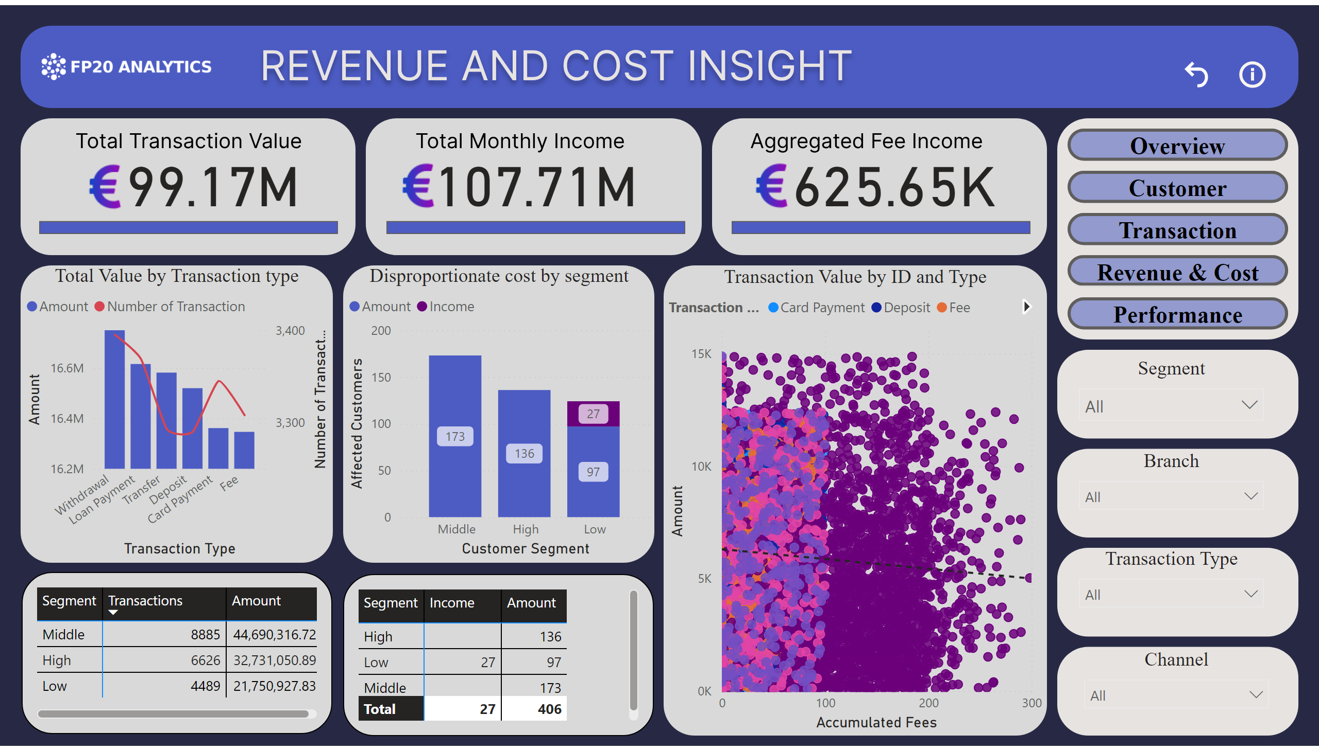
Revenue and cost
Notes:
Segment
No alt text provided
Branch
No alt text provided
Channel
No alt text provided
actionButton
No alt text provided
Transaction Type
No alt text provided
actionButton
No alt text provided
actionButton
No alt text provided
actionButton
No alt text provided
actionButton
No alt text provided
actionButton
No alt text provided
image
No alt text provided
actionButton
No alt text provided
image
No alt text provided
hundredPercentStackedBarChart
No alt text provided
hundredPercentStackedBarChart
No alt text provided
hundredPercentStackedBarChart
No alt text provided
card
No alt text provided
image
No alt text provided
image
No alt text provided
image
No alt text provided
card
No alt text provided
card
No alt text provided
Disproportionate cost by segment
No alt text provided
Total Value by Transaction type
No alt text provided
pivotTable
No alt text provided
Transaction Value by ID and Type
No alt text provided
pivotTable
No alt text provided
image
No alt text provided

Slide 6
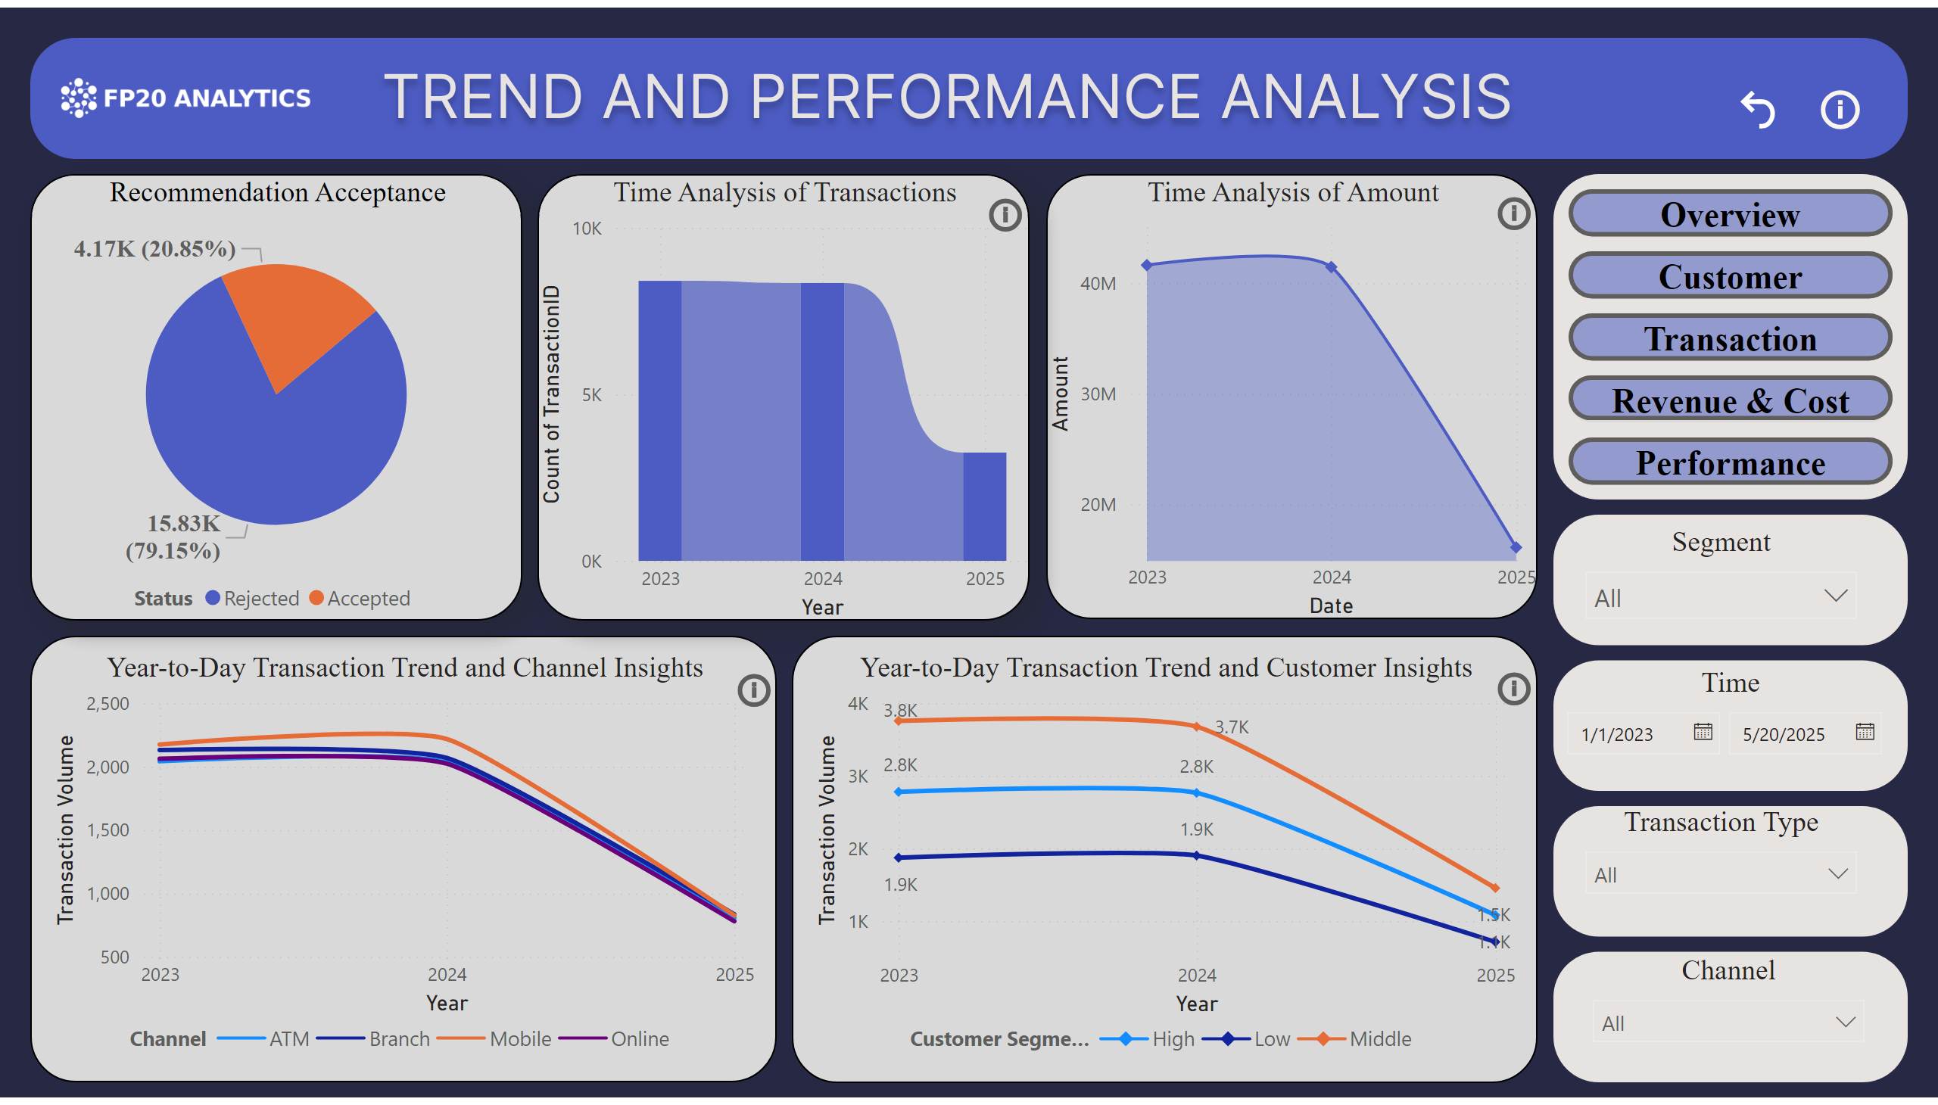
Trend and Performance analytics
Notes:
Year-to-Day Transaction Trend and Customer Insights
No alt text provided
actionButton
No alt text provided
actionButton
No alt text provided
actionButton
No alt text provided
actionButton
No alt text provided
card
No alt text provided
card
No alt text provided
card
No alt text provided
card
No alt text provided
Segment
No alt text provided
Time
No alt text provided
Channel
No alt text provided
actionButton
No alt text provided
Transaction Type
No alt text provided
actionButton
No alt text provided
actionButton
No alt text provided
actionButton
No alt text provided
actionButton
No alt text provided
actionButton
No alt text provided
image
No alt text provided
actionButton
No alt text provided
image
No alt text provided
image
No alt text provided
Year-to-Day Transaction Trend and Channel Insights
No alt text provided
Recommendation Acceptance
No alt text provided
Time Analysis of Amount
No alt text provided
Time Analysis of Transactions
No alt text provided
image
No alt text provided

